Slide 1

SAKÉ SEMINAR
MONTH DAY, YEAR
PRESENTED BY XXXX XXXXXX

Slide 2

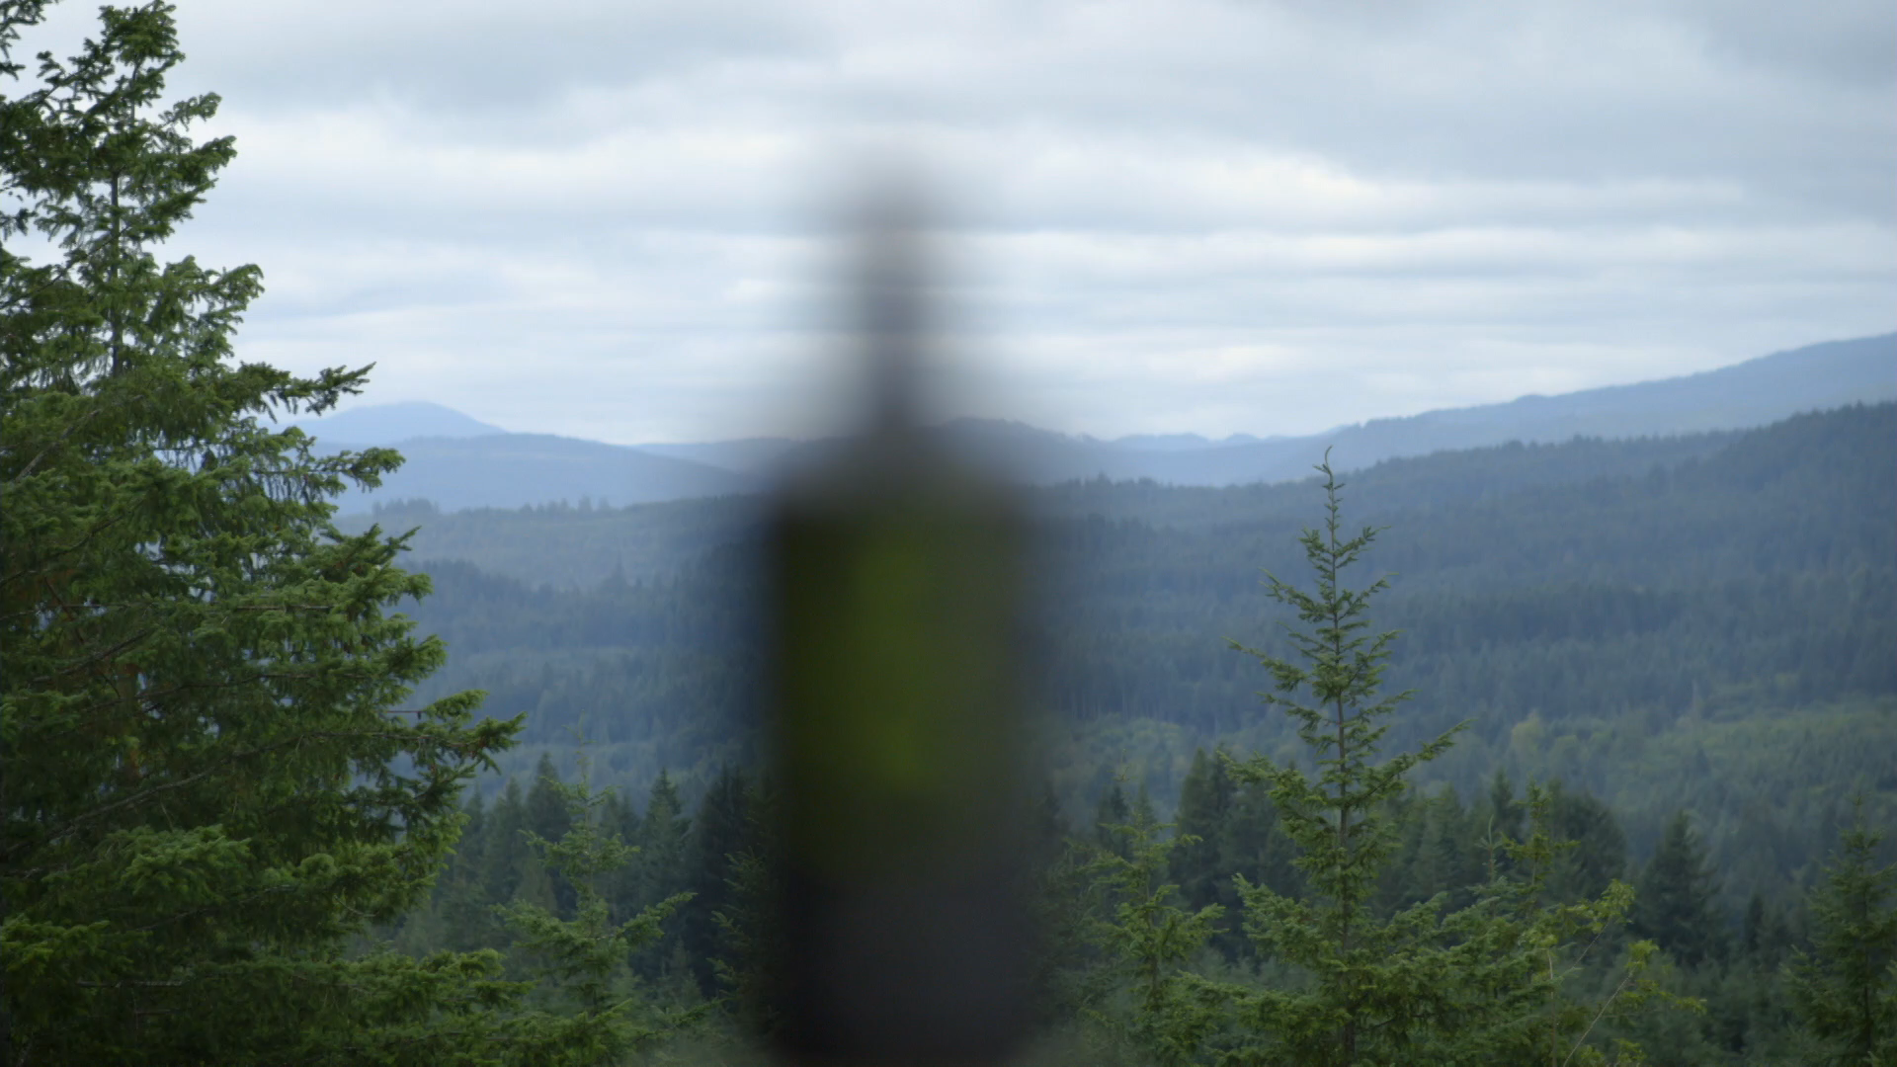
WHO ARE
WE?

Slide 3
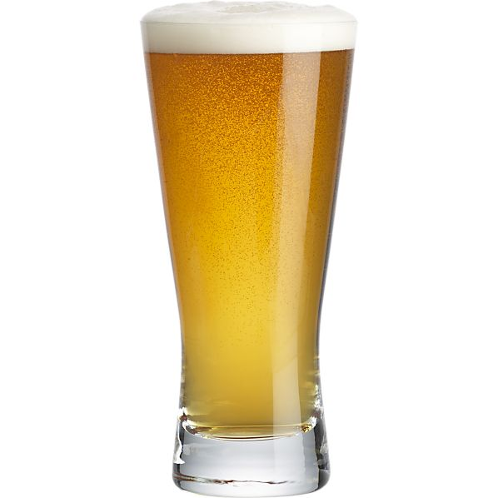
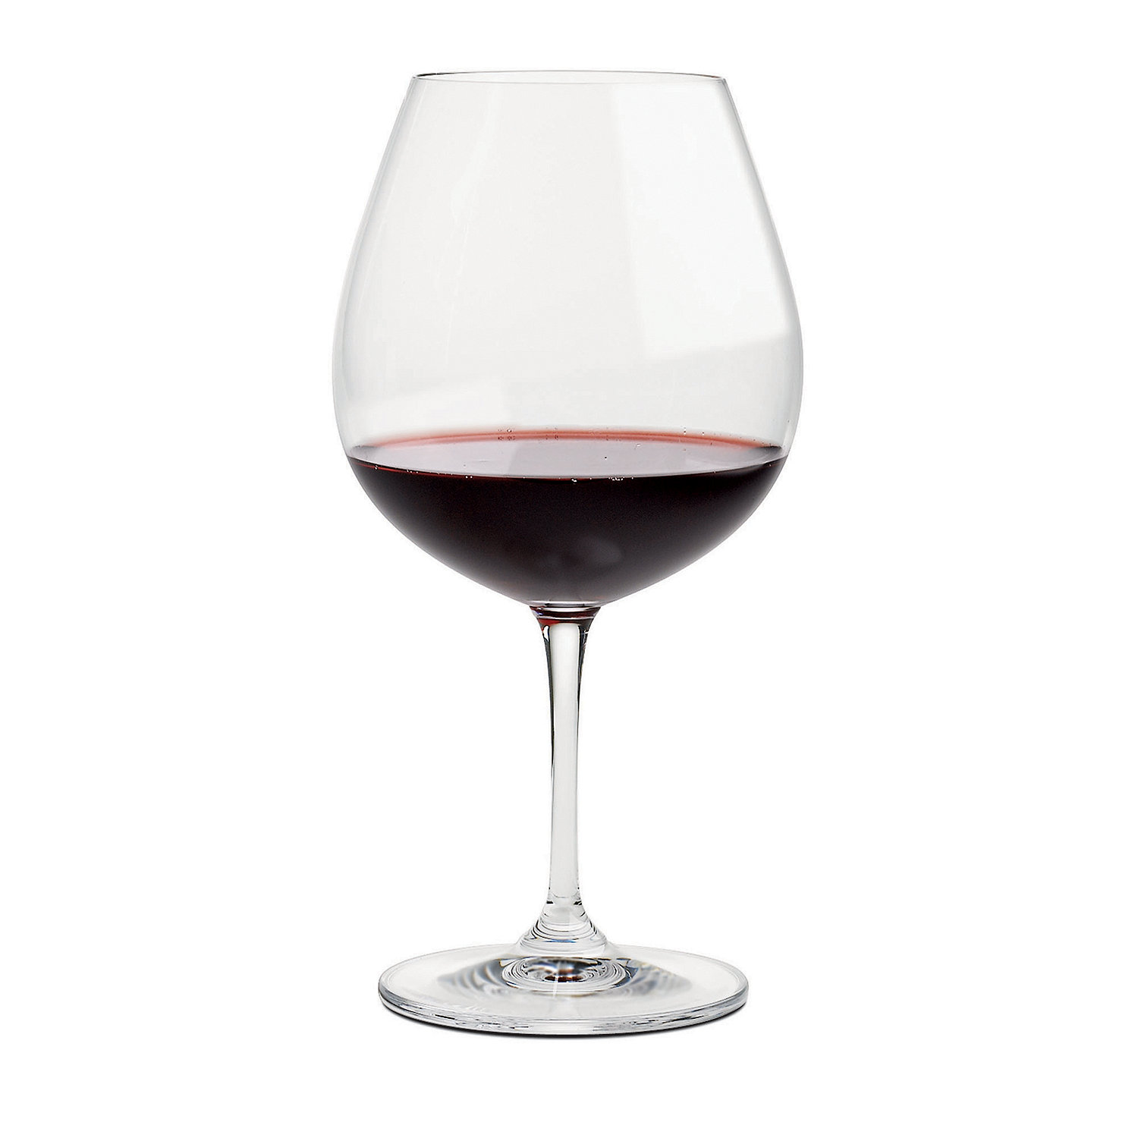
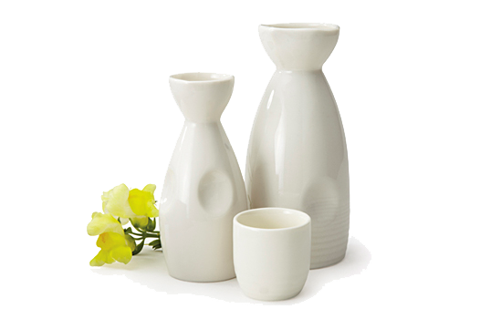
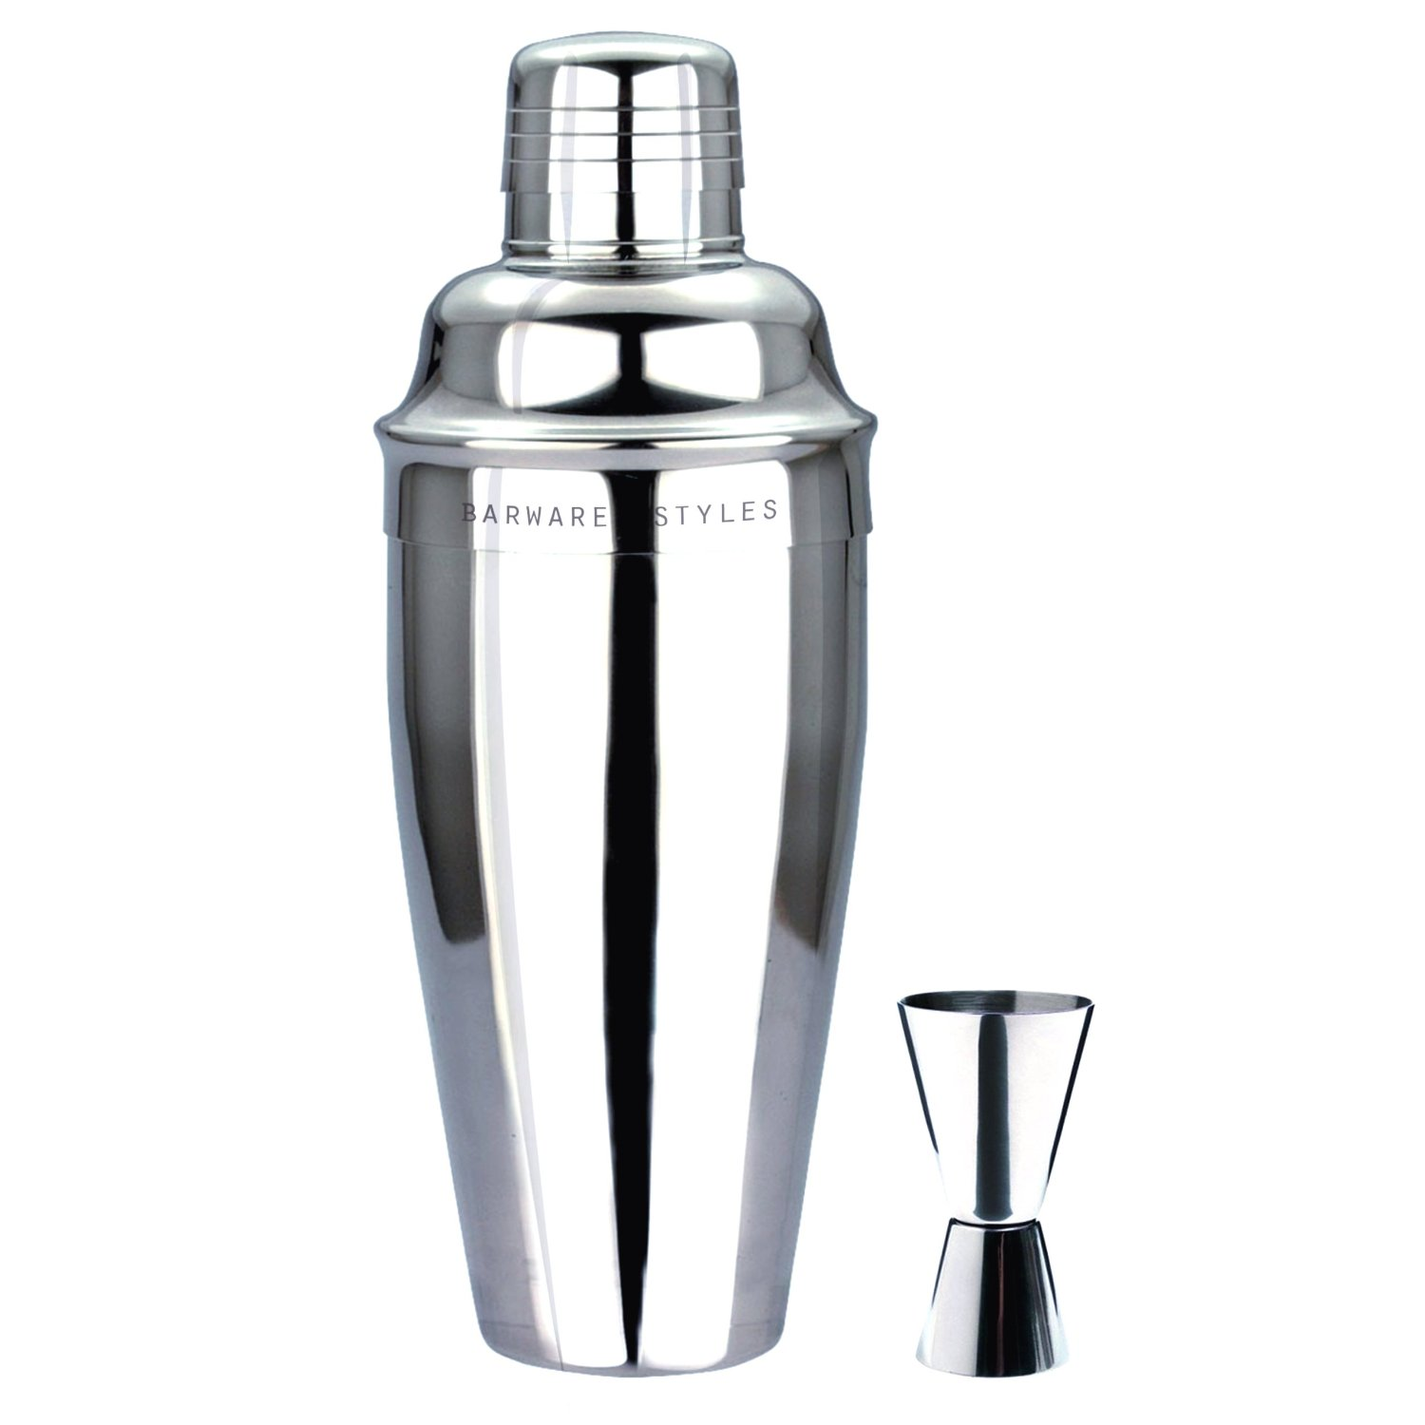
WHAT IS
SAKÉ?
SAKÉ （酒）
[sah-kay]
noun
1. a Japanese fermented, mildly alcoholic beverage made from rice.
BREWS
LIKE
BEER
DRINKS
LIKE
WINE
MIXES
LIKE
LIQUOR
TASTES
LIKE
SAKÉ

Slide 4
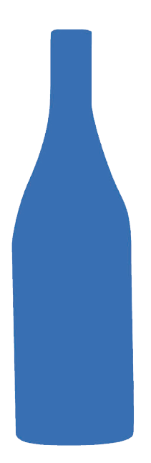
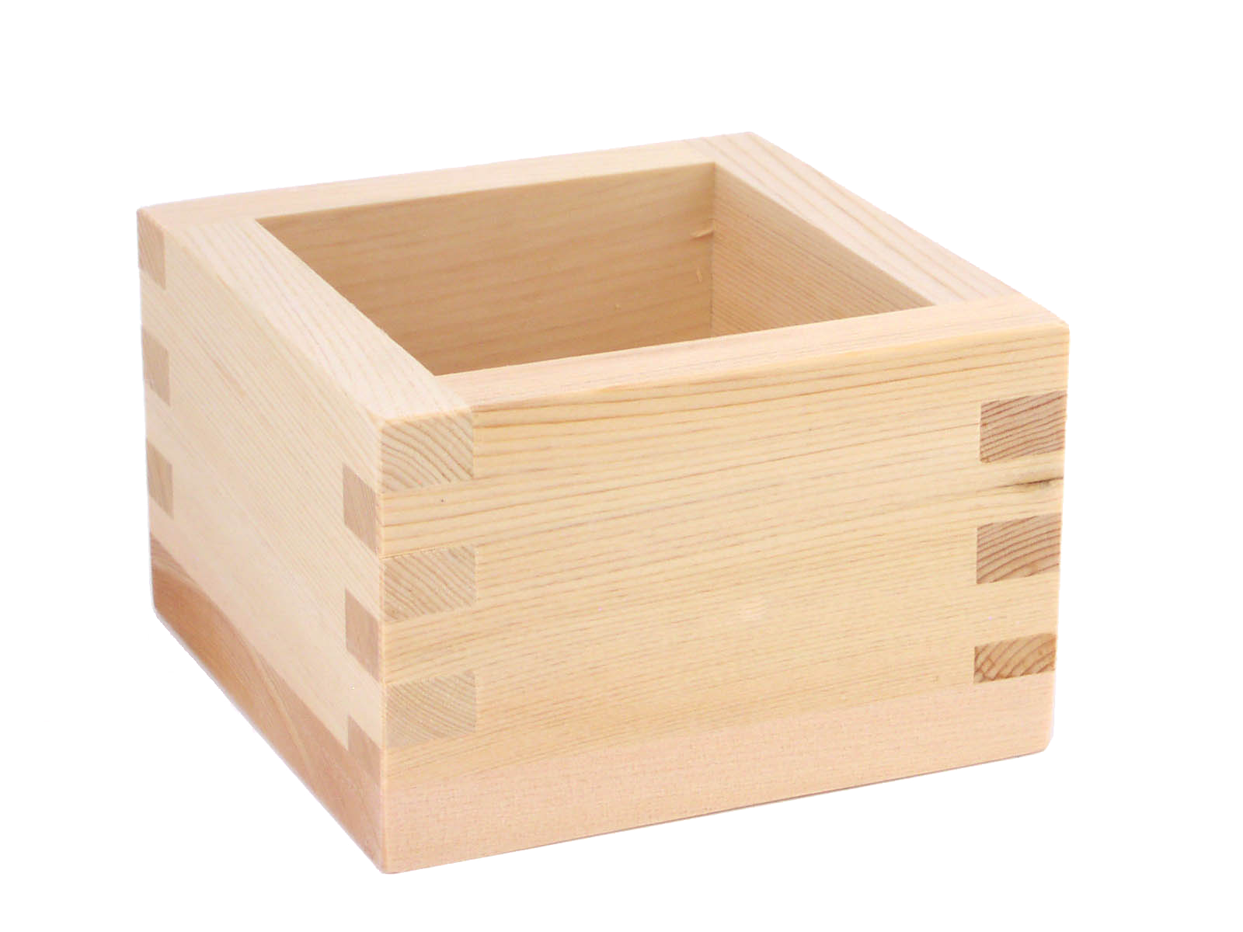
MYTHS AND
URBAN LEGENDS
Saké is distilled.
Saké is only served hot.
Saké is only for Japanese food.
Saké is only made in Japan.
It is brewed, similar to beer.
Premium saké is best served chilled. Hot saké in the USA is typically cheap quality.
Premium saké pairs incredibly well with a wide range of world cuisines.
Premium saké is made in Japan, USA, Australia, Canada, and Scotland.
Saké is best served in little wooden cups or little shot glasses.
Saké is for dropping into a pint of beer.
Saké is “rice wine”.
Saké is hangover free.
The best vessel for serving saké is a wine glass.
Saké bombs are for chugging beer and getting hammered, not enjoying sake.
Nope, it’s saké.
It may be easier on you but will still give you a hangover.

Slide 5
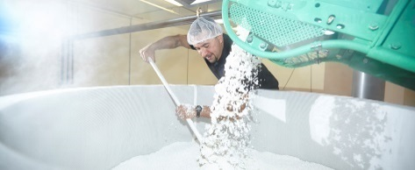
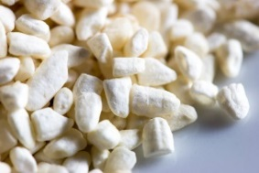
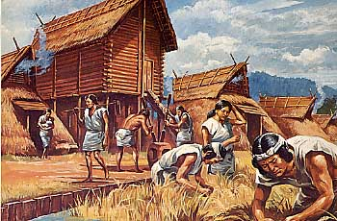
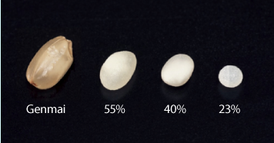
SAKÉ
HISTORY
Vienna International Exposition
Current Day Breweries
Saké makes its international debut at the Vienna International Exposition. Prior to this it was only exported to a few Asian countries and limited amounts to Russia.
Small craft brewers, modern techniques and development of super yeasts and severe polish grow the category and continue to improve the quality of product despite a downturn in consumption in Japan
KOJI from China
Koji needed in saké production. Without it there is no saké
300 B.C.
800 A.D.
1570
1873
1945
1975
1992
The Beginnings
Pasteurization
War Years
Saké Grading
Thought to have begun in Japan around the 3rd century B.C soon after the arrival of rice cultivation.
Quality would once again be improved with the discovery of pasteurization and clean storage practices. This occurred long before Louis Pasteur was born (1822).
All saké was Junmai up until WWII. During the war, pure alcohol and glucose were added to small quantities of rice mash. 75% of todays sake is made using this technique.
Use of rice polish ratio introduced to determine quality grading of saké. This led to the current day categories of Ginjo and Daiginjo.

Slide 6
SAKÉ VS.
WINE
WINE
Alcohol Fermentation
Grapes
(Sugar = Glucose)
Wine
(Alcohol, C0₂)
Yeast
SAKÉ
The process of breaking a complex carbohydrate into simple sugars
Saccharification
Alcohol Fermentation
Saké Rice
(Starch)
Sugar
(Glucose)
Saké
(Alcohol, C0₂)
Koji
Yeast
From John Gauntner

Slide 7
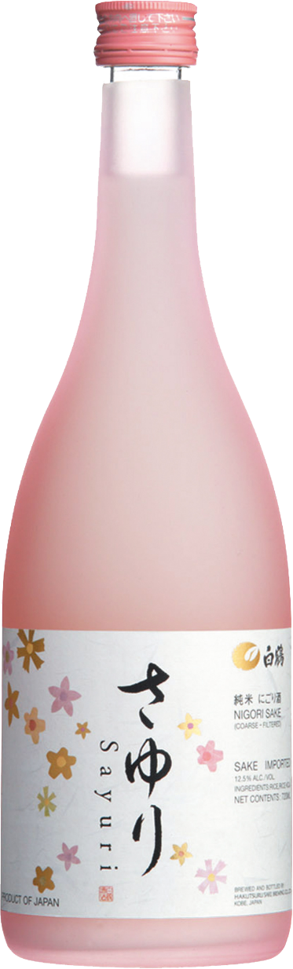
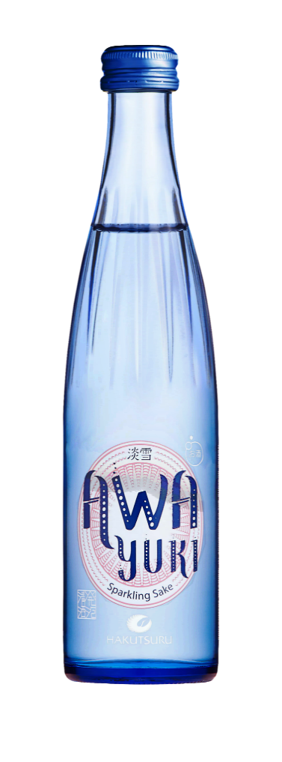
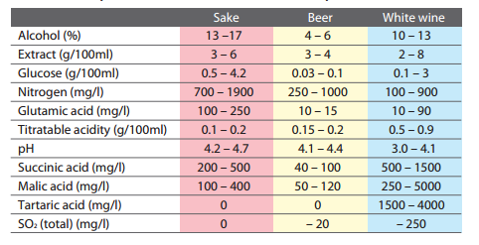
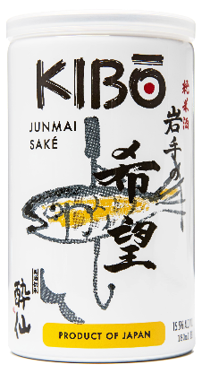
UNIQUENESS
OF SAKÉ
A single batch of saké can be managed in dozens
of ways to end up with dozens of styles
Saké is brewed from rice (no other grain) with water, yeast and koji being the only other ingredients
Chart from “A Comprehensive Guide to Japanese Saké” via Japan Saké and Shochu Makers Association

Slide 8
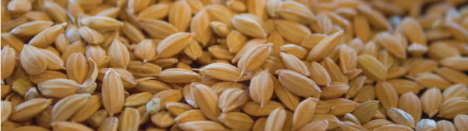
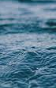
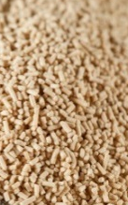
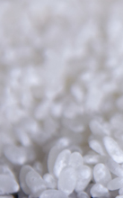
BREWING
JUNMAI SAKÉ
SAKÉ INGREDIENTS
1. RICE & WATER
2. MILL & POLISH
RICE
WATER
YEAST
KOJI
Start with fresh, pure water and good quality rice.
The longer each grain is milled, the finer the saké quality.
Specialty grade saké rice is used to produce flavor
A good source of water is key to quality saké
Converts the rice sugars into alcohol
Converts the rice starch to sugars for the yeast
3. WASH, STEAM, COOL
4. KOJI
5. MOTO YEAST
6. FERMENTATION
7. PRESSING
To help facilitate the growth of the Koji mold.
Koji mold is carefully applied to the freshly steamed rice and cultivated in a warm, humid environment.
All ingredients come together to nurture a dense yeast culture.
Yeast consumes sugars the Koji is creating from the rice starch.
Fermented saké is pushed through filter panels to remove varying levels of sediment.
8. FILTRATION
9. PASTEURIZATION
10. MATURATION
11. BLEND/DILUTE
12. BOTTLING
Inhibits coloring and aging.
Stops fermentation and stops the product from spoiling.
Crisp, lively flavors mellow to earthier, deeper flavors.
This step is optional. Most saké is diluted from 20 to 15% ABV.
Enjoy!

Slide 9
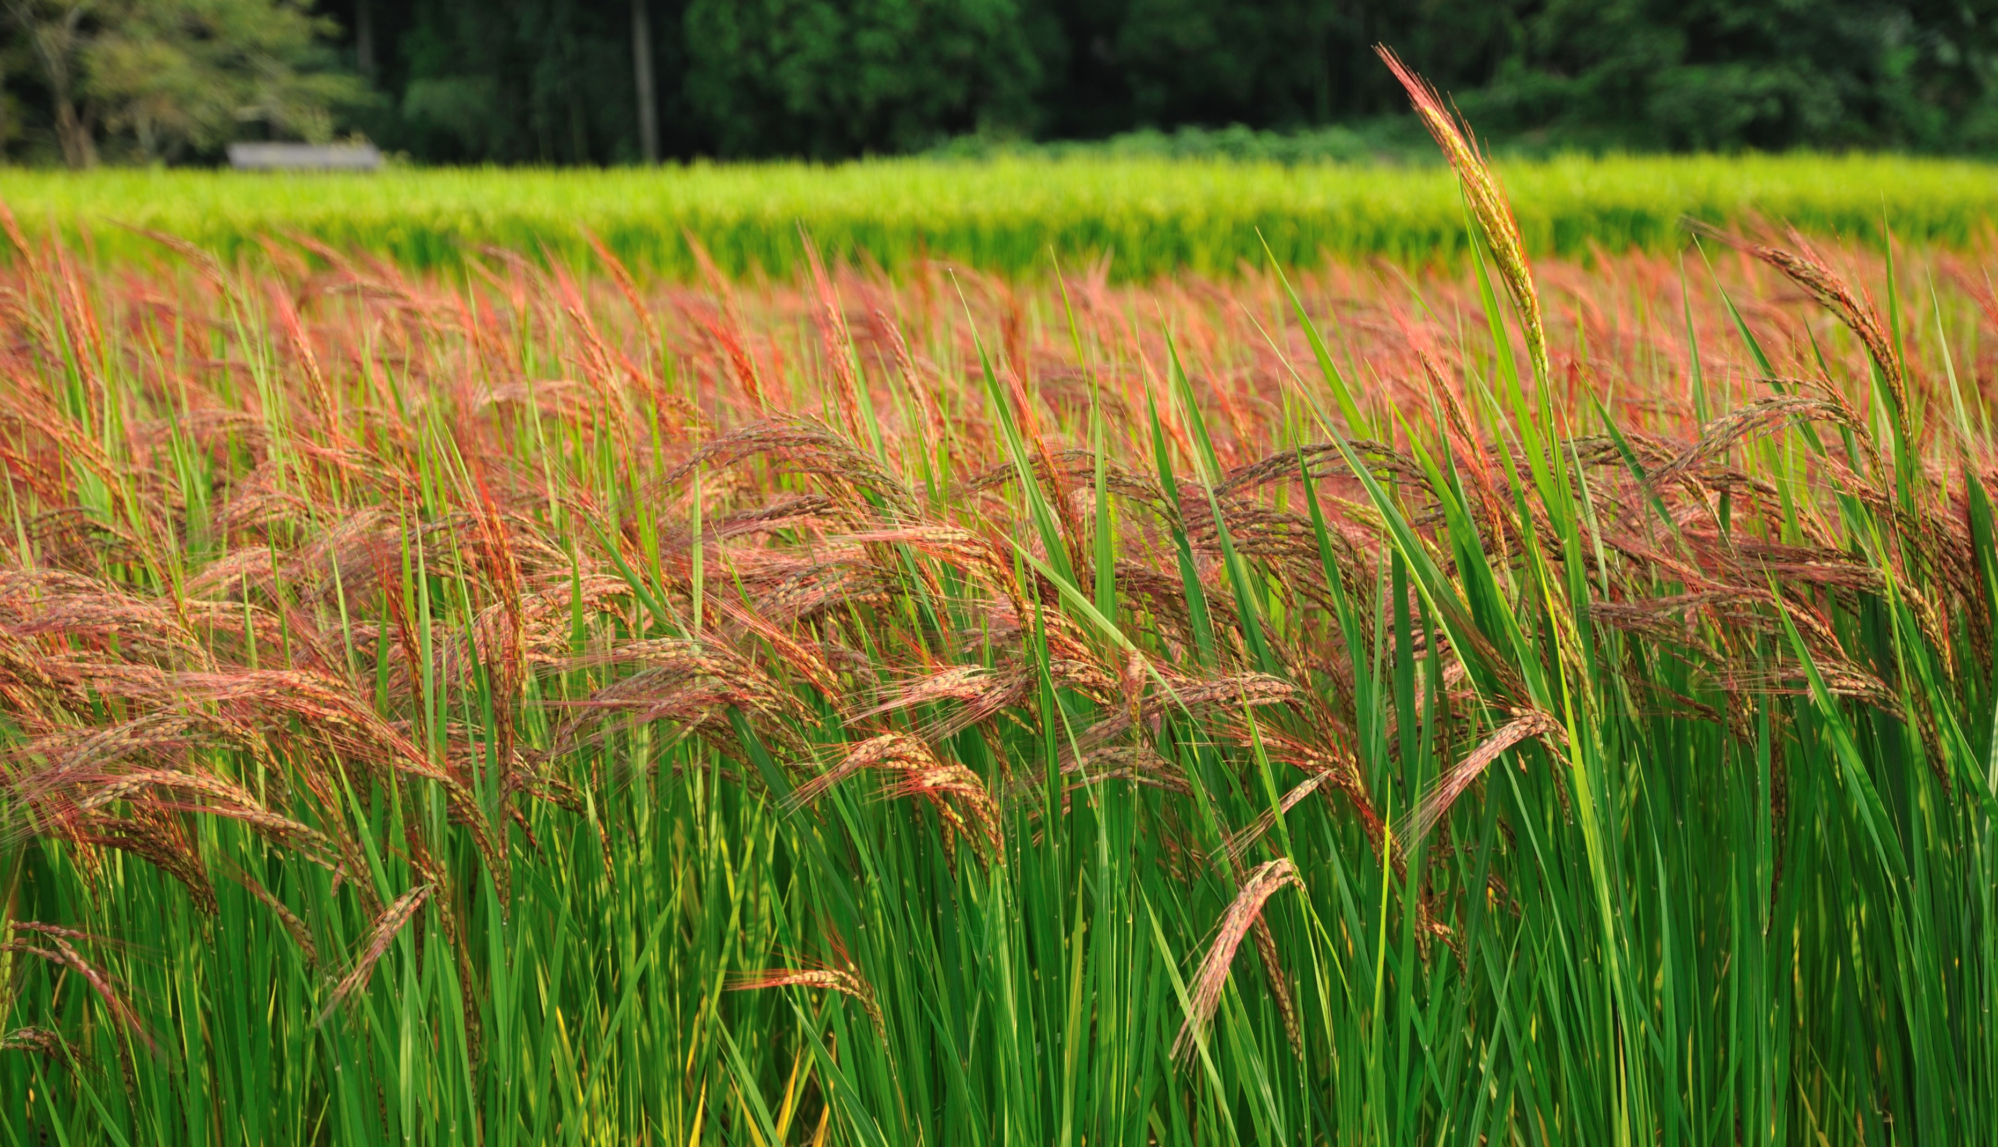
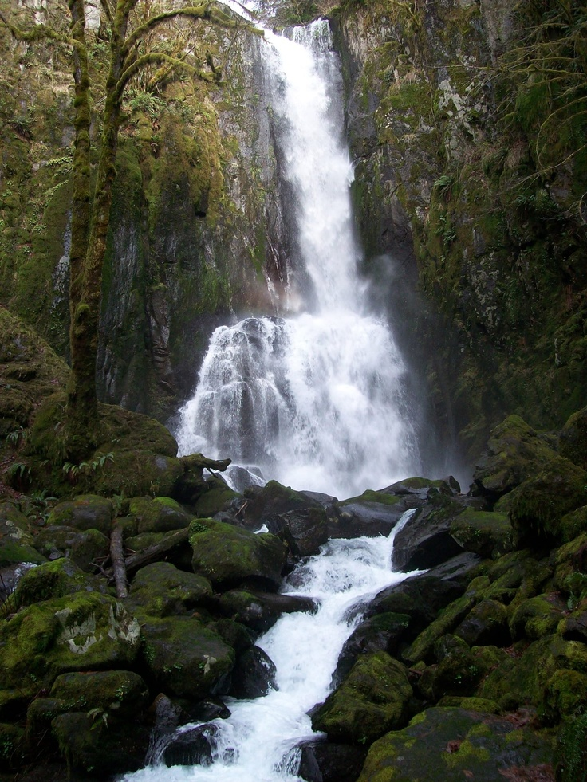
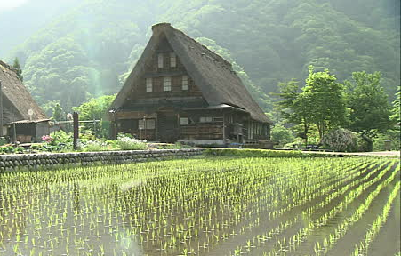
BREWING
PROCESS
1. RICE & WATER
Start with fresh, pure water and good quality rice.

Slide 10
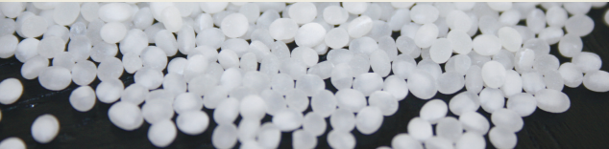
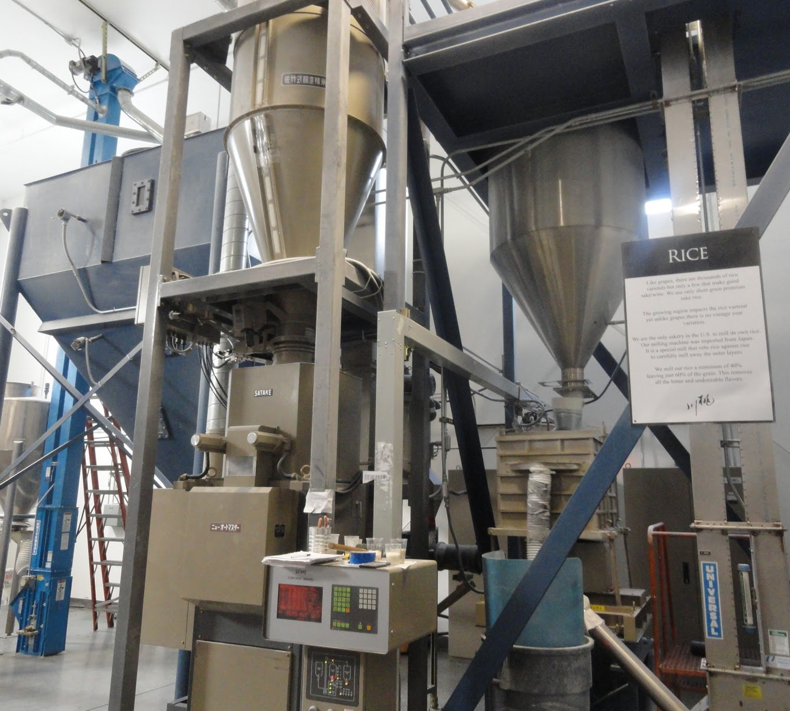
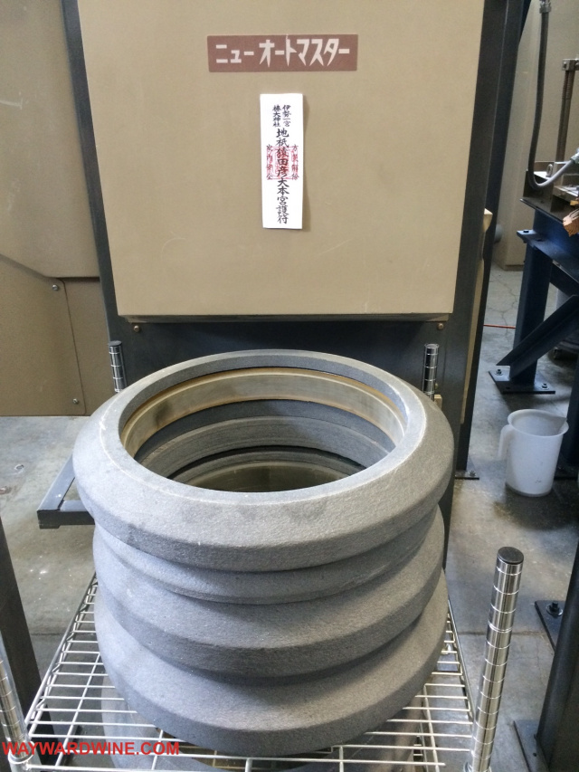
BREWING
PROCESS
2. MILL & POLISH
The longer each grain is milled, the finer the saké quality.

Slide 11
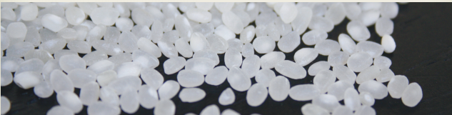
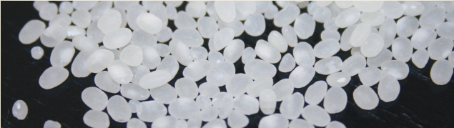
RICE
POLISHES
UNPOLISHED RICE
Primarily covered in proteins and fats.
JUNMAI
Typically polished to at least 70%, though not legally required for Junmai statement.
GINJO
Polished to at least 60%, which defines premium level saké.
DAIGINJO
Polished to at least 50%, which defines super premium level saké.

Slide 12
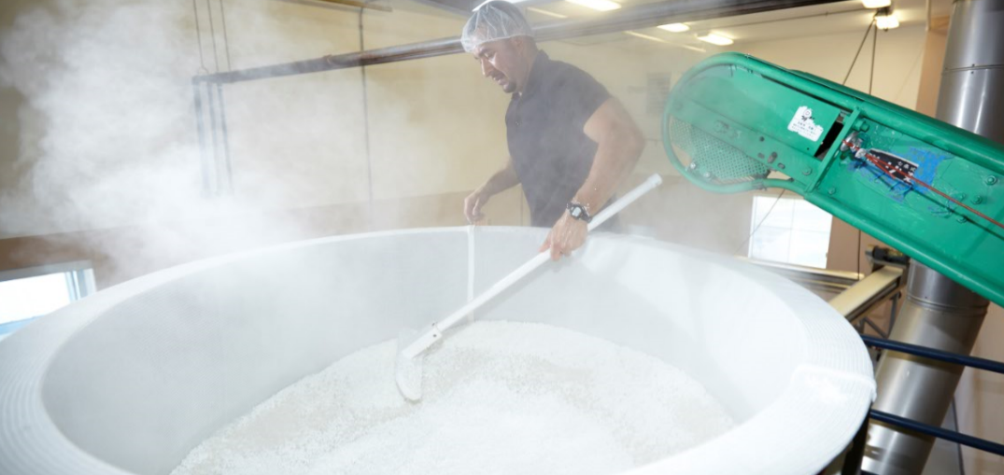
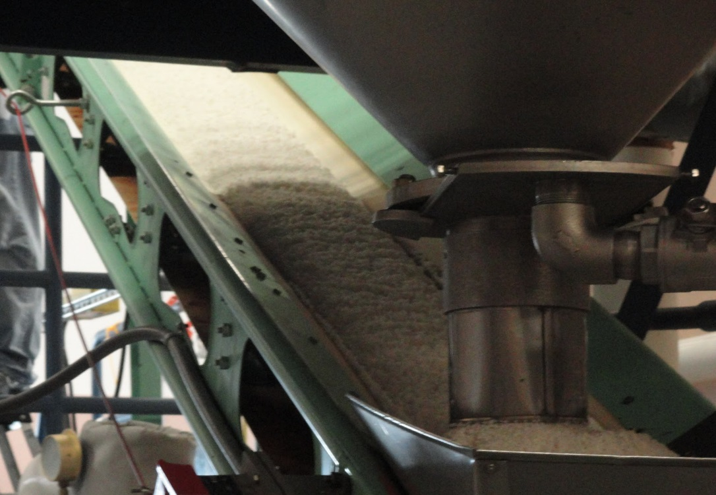
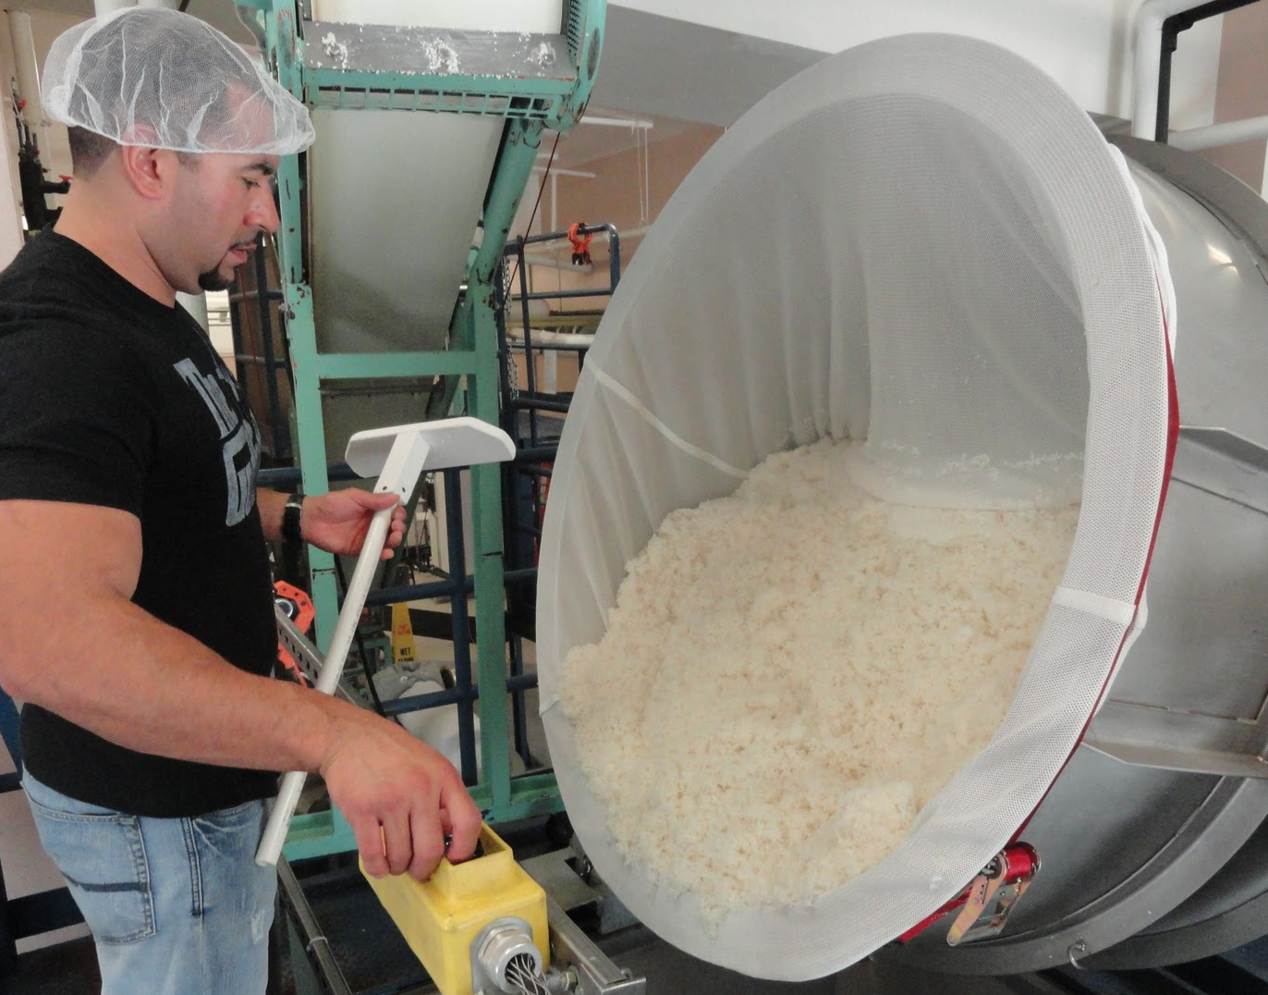
BREWING
PROCESS
3. WASH, STEAM, COOL
To help facilitate the growth of the Koji mold.

Slide 13
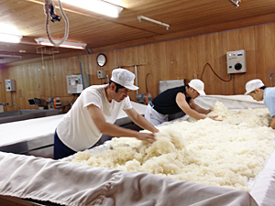
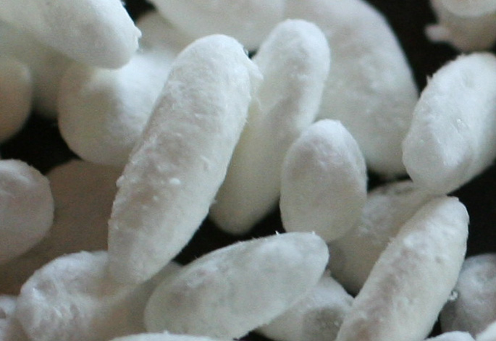
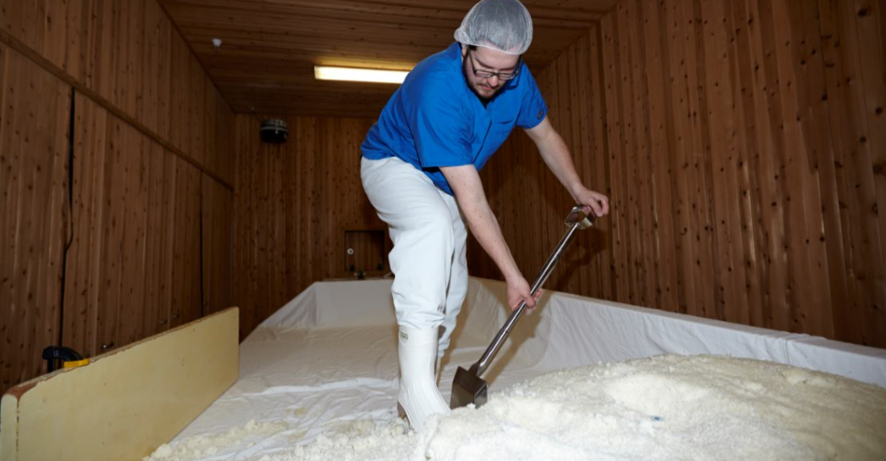
BREWING
PROCESS
4. KOJI
Koji mold is carefully applied to the freshly steamed rice and cultivated in a warm, humid environment.

Slide 14
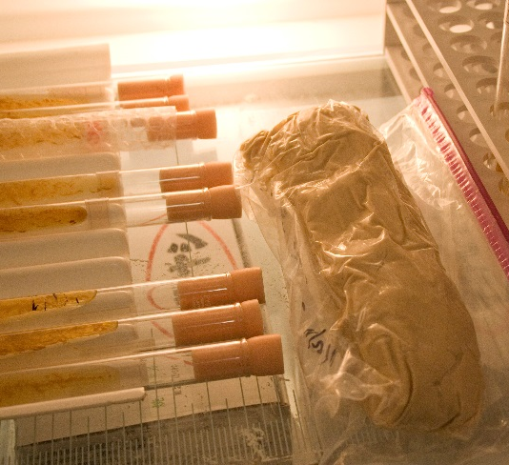
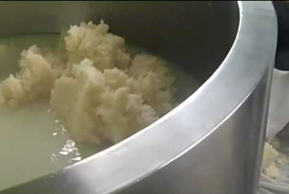
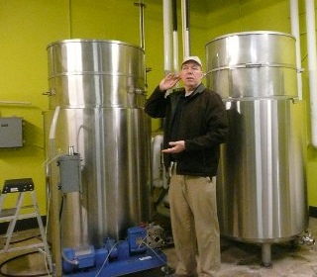
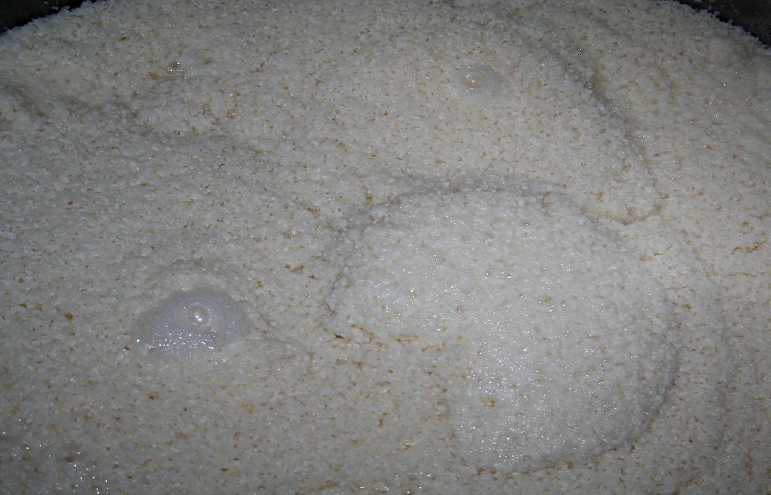
Yeast
BREWING
PROCESS
5. MOTO YEAST
All ingredients come together to nurture a dense yeast culture.
Moto “Starter” Tanks

Slide 15
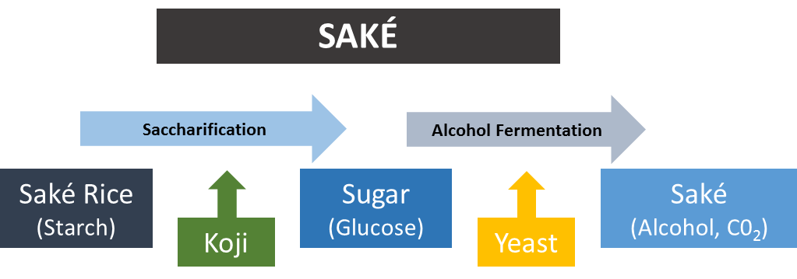
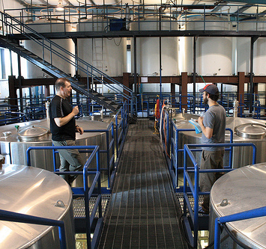
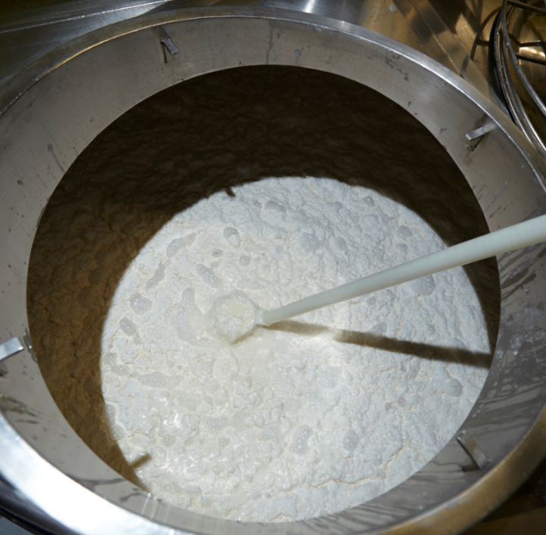
BREWING
PROCESS
6. FERMENTATION
Yeast consumes sugars the koji is creating from the rice starch.

Slide 16
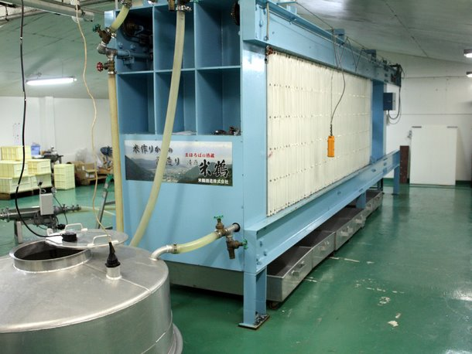
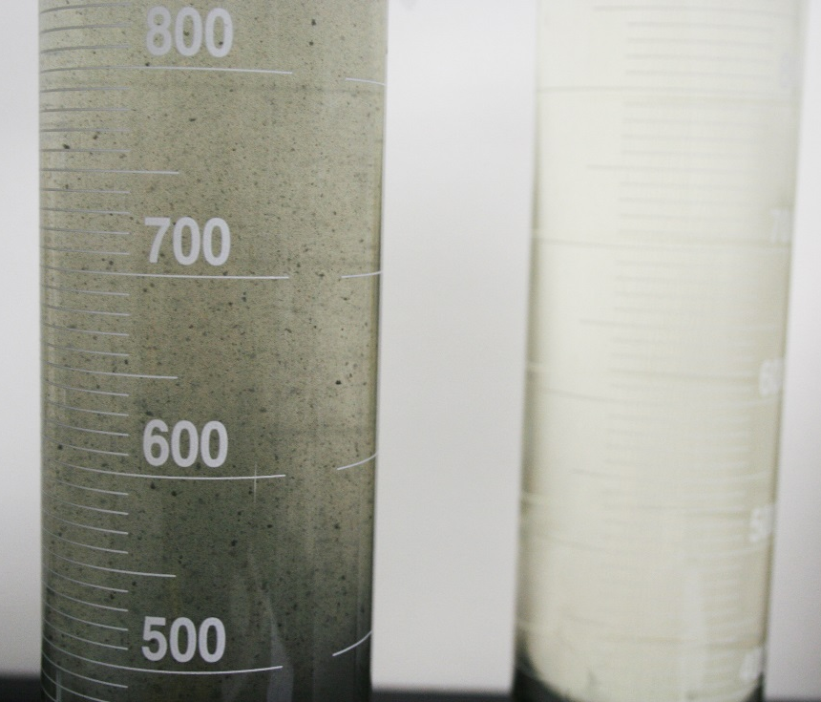
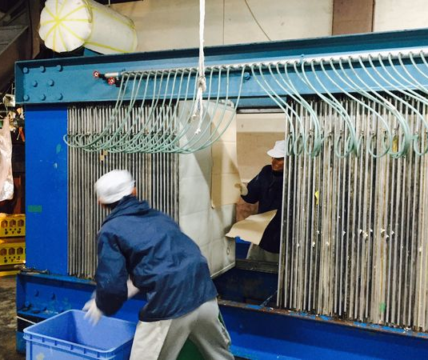
BREWING
PROCESS
7. PRESSING
Fermented saké is pushed through filter panels to remove varying levels of sediment.
8. FILTRATION
Inhibits coloring and aging.

Slide 17
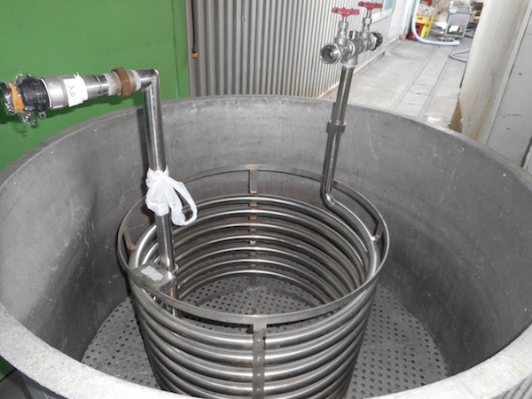
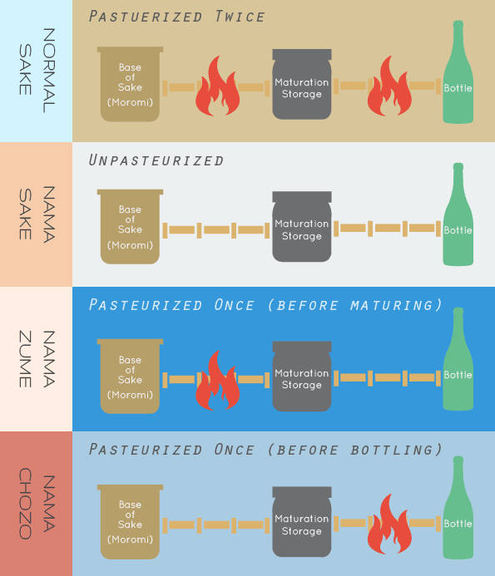
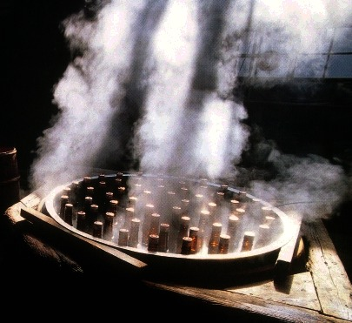
BREWING
PROCESS
9. PASTEURIZATION
Stops fermentation and stops the product from spoiling.

Slide 18
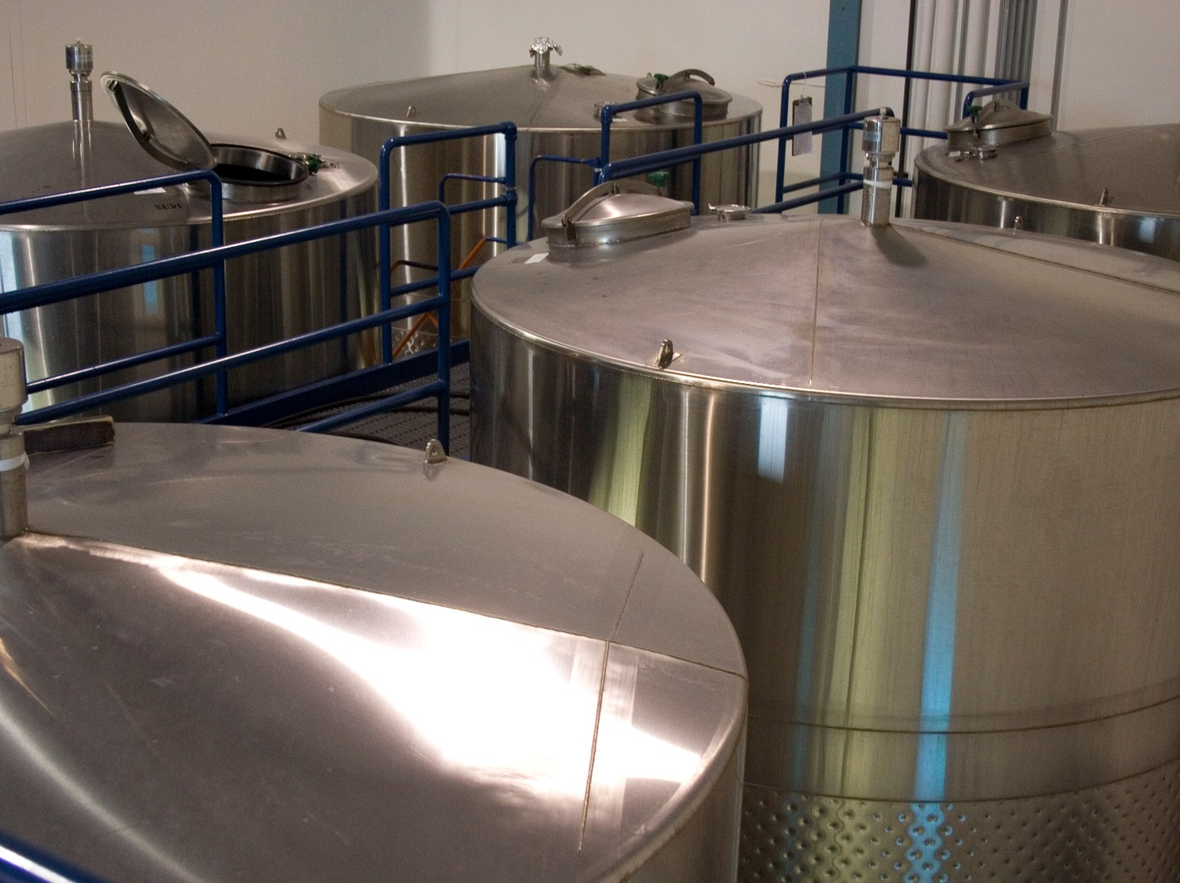
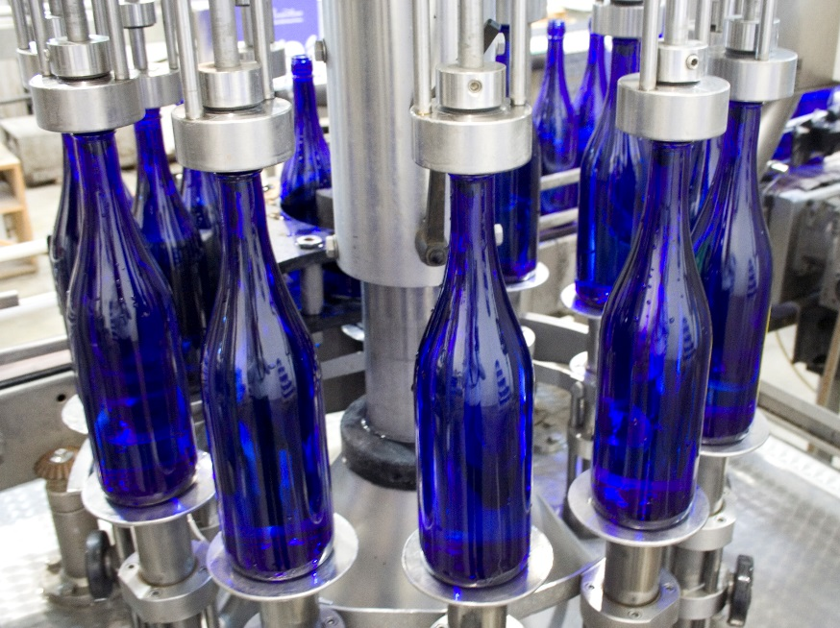
BREWING
PROCESS
10. MATURATION
Crisp, lively flavors mellow to earthier, deeper flavors.
11. BLEND/DILUTE
This step is optional. Most saké is diluted from 20 to 15% ABV.
12. BOTTLING
Enjoy!

Slide 19
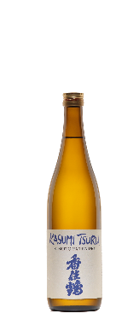
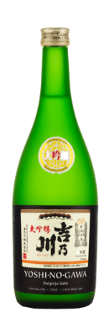





SAKÉ
CLASSIFICATIONS
DAIGINJO
GINJO
HONJOZO
FUTSU
A form of ginjo made with highly polished rice. Has a more refined taste.
Fermentation occurs at a lower temp. and takes longer. Should be smooth in texture and have a good aftertaste.
The emphasis is on flavor and there are few fruity elements. It has a higher level of acidity and umami.
Ordinary or value saké, that is the equivalent to table wine and accounts for the majority of saké produced.
JUNMAI DAIGINJO
JUNMAI GINJO
JUNMAI
UMAMI DEFINITION
Regarded as the highest grade of saké. Delivers a good blend of refined taste with acidity and umami.
The acidity and umami are toned down and there is a clear fruity fragrance. There are no requirements regarding polish.
Made only from rice, koji, yeast and water. This style highlights the flavor of the rice and koji more than other varieties.
The “savoriness” or “deliciousness” that comes from amino acids. It can be similar to the subtle flavors found in fish, cheese, tomatoes or dried mushrooms.

Slide 20

SAKÉ CLASSIFICATION SYSTEM

Slide 21









ASSOCIATED STYLES / SUB CLASSIFICATIONS
KARAKUCHI
TOKUBETSU
SPARKLING
PRODUCTION TECHNIQUES
Dry in flavor.
Designates a “special” saké. Often made with rice milled more than standard.
Saké is carbonated by trapping C0₂ produced from second yeast fermentation, or by injecting C0₂.
NAMA
KIMOTO
YAMAHAI
Saké that has not been pasteurized.
A different process in the development of the saké where the rice is smashed with a pole to create a high level of natural lactic acid.
Similar to the Kimoto saké, but without the use of poles to smash the rice.
Chart from “A Comprehensive Guide to Japanese Saké” via Japan Saké and Shochu Makers Association
GENSHU
NIGORI
INFUSED
Undiluted saké. Cask strength.
Unfiltered saké. It is typically cloudy.
An American twist. Simply means flavor was added to the saké.

Slide 22



SAKÉ AGEBILITY, STORAGE & SERVICE
SAKÉ SERVICE VESSELS
SAKÉ AGEBILITY
Most saké is ready to drink the moment it leaves the brewery
No need to age saké in cellar
Generally, saké should be consumed within 1.5 years of release
Once opened, saké will last a minimum of four weeks in the refrigerator without any noticeable degradation
Always store saké away from heat and UV light, preferably chilled
Tokkuri
Ochoko
Masu
“Daiginjo”
By Riedel

Slide 23




OUR
KURA

Slide 24






OUR
PARTNERS

Slide 25



















OUR
PORTFOLIO
JUNMAI DAIGINJO & DAIGINJO
JUNMAI GINJO
&
GINJO
JUNMAI
HONJOZO
All Moonstone, Momokawa, and G products are Junmai Ginjo quality
FUTSU
*graph data from Saké-exporter.com

Slide 26
THANK YOU

